Slide 1
Randomized Algorithms CS648
Lecture 2
Approximate Median
Algebraic Techniques : Fingerprinting Techniques

Slide 2
How to generate random numbers?
Pseudorandom number generator (PNRG)
Good for all practical applications
Homework:
Study from the net or other sources
“Generating random numbers in C++”
using Mersenne Twister

Slide 3
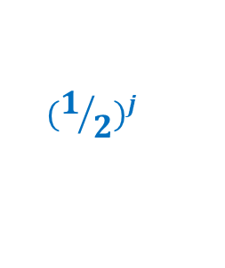
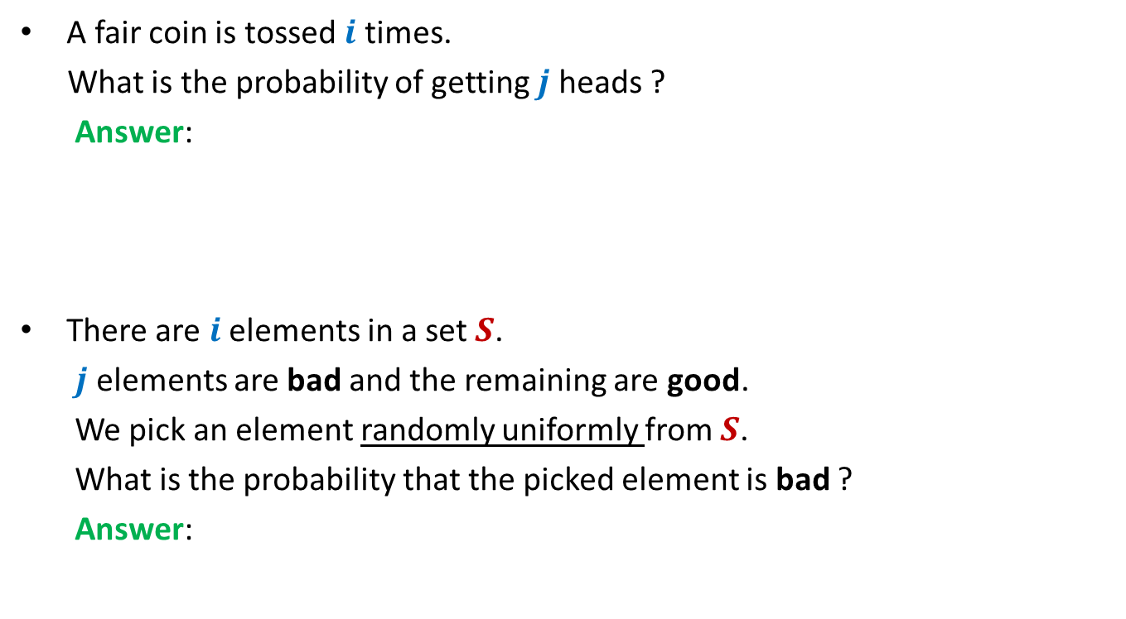
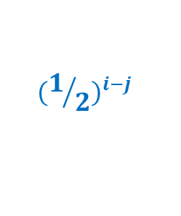


Very basic questions in probability
A fair coin is tossed $i$ times.
What is the probability of getting $j$ heads ?
Answer:
There are $i$ elements in a set $S$.
$j$ elements are bad and the remaining are good.
We pick an element randomly uniformly from $S$.
What is the probability that the picked element is bad ?
Answer:
$$\left(\begin{matrix}i \\ j\end{matrix}\right)$$
$${(1/2)}^{j}$$
$${ (1/2)}^{i−j}$$
$$\frac{j}{i}$$

Slide 4


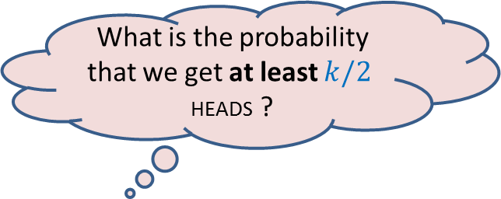
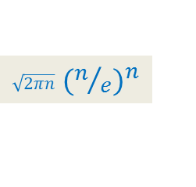
A simple probability exercise
P[HEADS] = ¼
P[TAILS] = ¾
The coin is tossed $k$ times.
[Stirling’s approximation for Factorial: $n! ≈$ ? ]
What is the probability that we get at least $k/2$ HEADS ?
$\sqrt{2πn}$ ${(n/e)}^{n}$

Slide 5
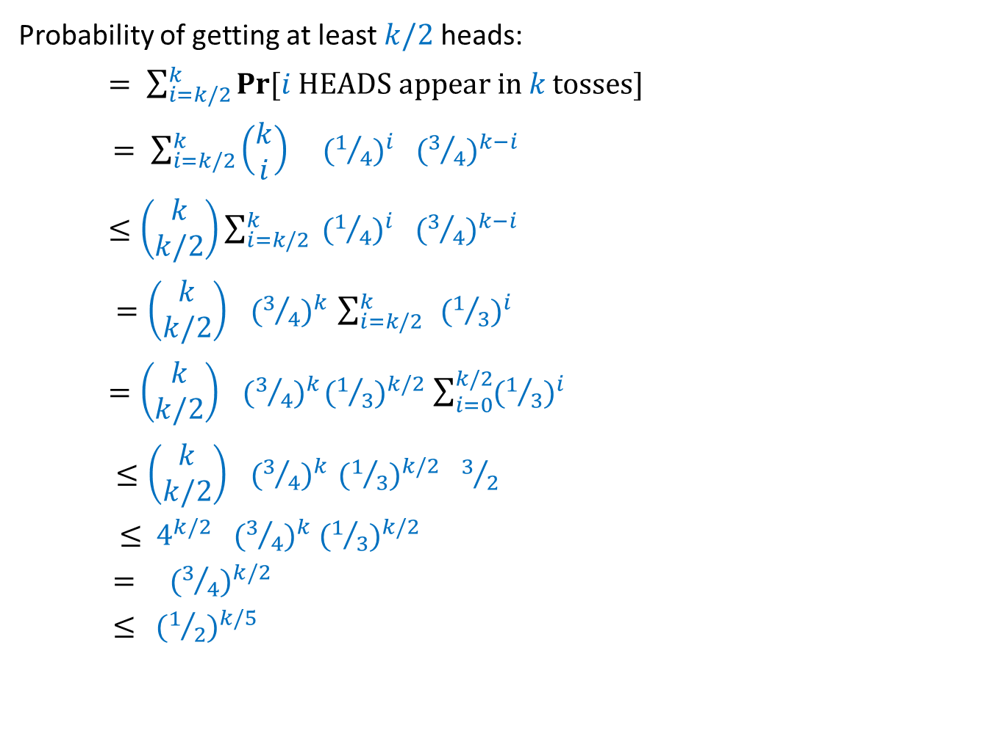

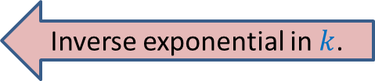
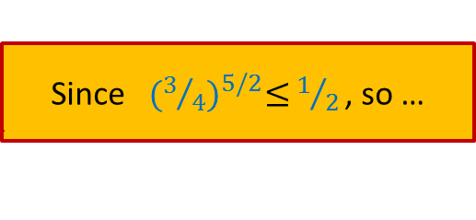
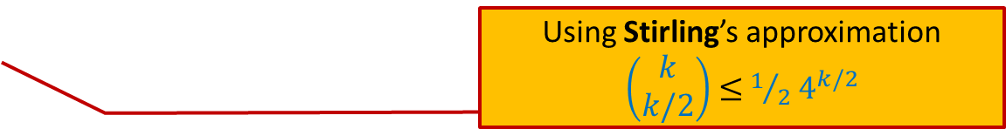
Probability of getting “at least $k/2$HEADS in $k$tosses”
Probability of getting at least $k/2$heads:
$= \sum_{i=k/2}^{k}{Pr\text{[}i \text{HEADS} \text{appear} \text{in} k \text{tosses}\text{]}}$
$= \sum_{i=k/2}^{k}{\left(\begin{matrix}k \\ i\end{matrix}\right) }{ (1/4)}^{i}{ (3/4)}^{k−i}$
$≤\left(\begin{matrix}k \\ k/2\end{matrix}\right)\sum_{i=k/2}^{k}{ {(1/4)}^{i}{ (3/4)}^{k−i}}$
$=\left(\begin{matrix}k \\ k/2\end{matrix}\right){ (3/4)}^{k} \sum_{i=k/2}^{k}{ }{(1/3)}^{i}$
$=\left(\begin{matrix}k \\ k/2\end{matrix}\right){ (3/4)}^{k}{(1/3)}^{k/2} \sum_{i=0}^{k/2}{{(1/3)}^{i}}$
$≤\left(\begin{matrix}k \\ k/2\end{matrix}\right){ (3/4)}^{k} {(1/3)}^{k/2}{ 3}/2$
$≤$ $4^{k/2}{ (3/4)}^{k} {(1/3)}^{k/2}$
$=$ ${ (3/4)}^{k/2}$
$≤{ (1/2)}^{k/5}$
Using Stirling’s approximation
$\left(\begin{matrix}k \\ k/2\end{matrix}\right)$ $≤$ $1/2$ $4^{k/2}$
Inverse exponential in $k$.
Since${ (3/4)}^{5/2}≤$ $1/{2 }$, so …

Slide 6
Example 1 : Approximate median

Slide 7

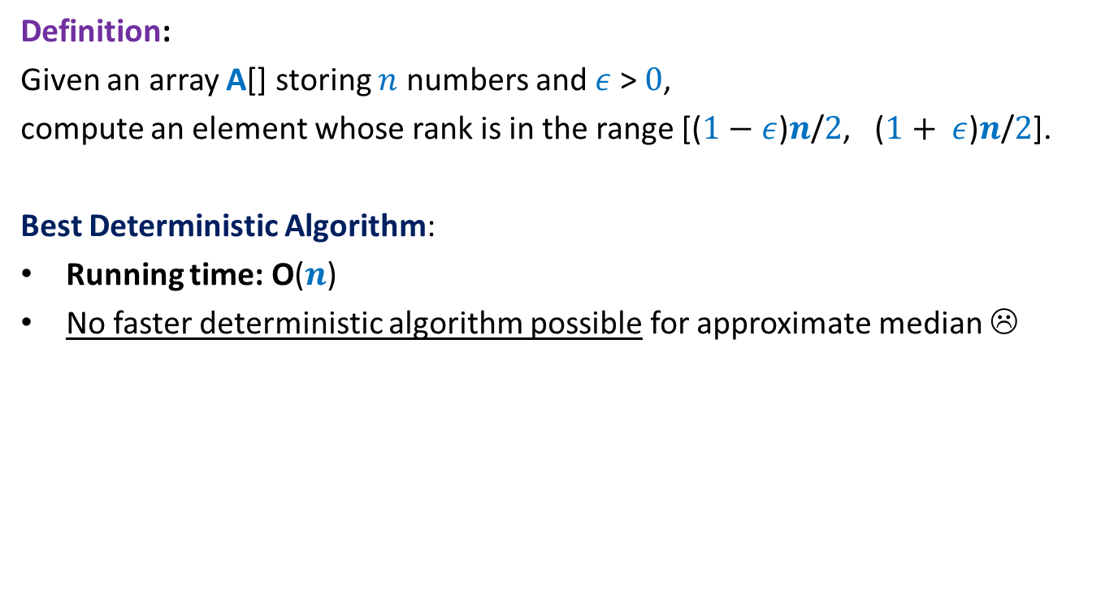

Approximate Median
Definition:
Given an array A[] storing $n$ numbers and $ε$ > $0$,
compute an element whose rank is in the range [($1−$ $ε$)$n$/$2$, ($1+ ε$)$n$/$2$].
Best Deterministic Algorithm:
Running time: O($n$)
No faster deterministic algorithm possible for approximate median ☹
$ε$ $=\frac{1}{2}$
Reason: At least $n/2$elements must be read. Otherwise, …
A$[1..n]$
½ - Approximate median elements could all be unread elements

Slide 8





½ - Approximate median
Half of the elements are good candidates to be ½ - Approximate median
If we pick an element randomly uniformly,
it is going to be ½ - Approximate median for the array with probability $1/2$.
$$n/4$$
Elements of A arranged in Increasing order of values
$$3n/4$$
Idea
O($1$) time
A$[1..n]$
in Output
On a few occasions

Slide 9
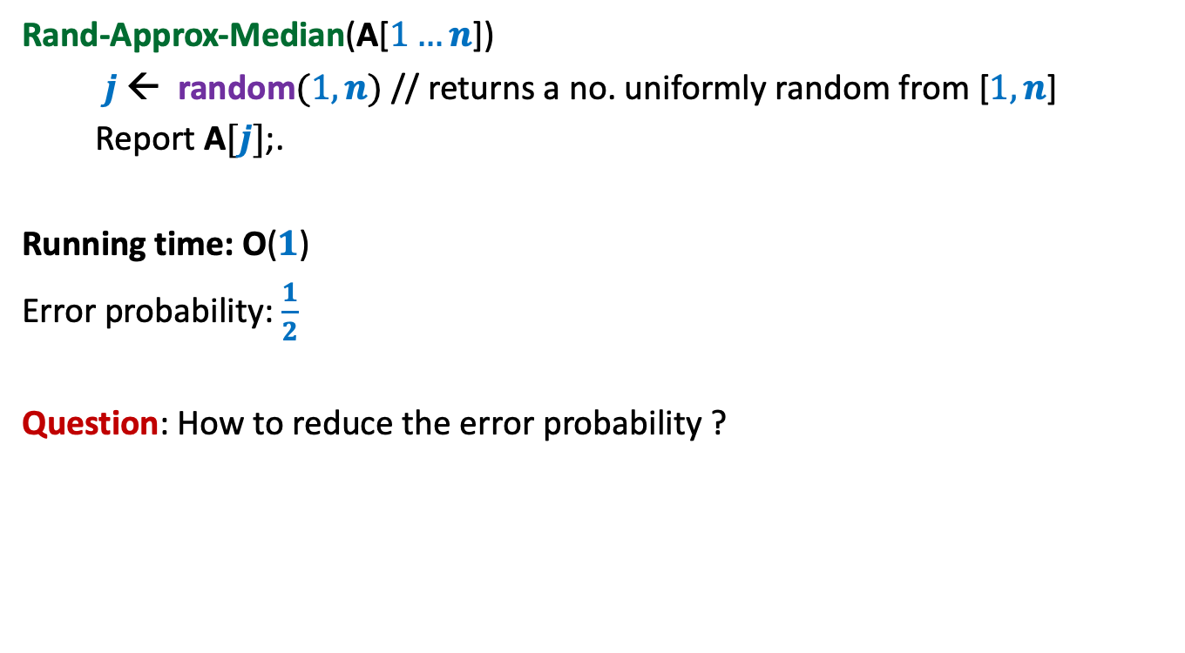
½ - Approximate median A Randomized Algorithm
Rand-Approx-Median(A[$1…n$])
$j$ ← random$(1,n)$ // returns a no. uniformly random from [$1,n$]
Report A$[j]$;.
Running time: O($1$)
Error probability: $\frac{1}{2}$
Question: How to reduce the error probability ?

Slide 10
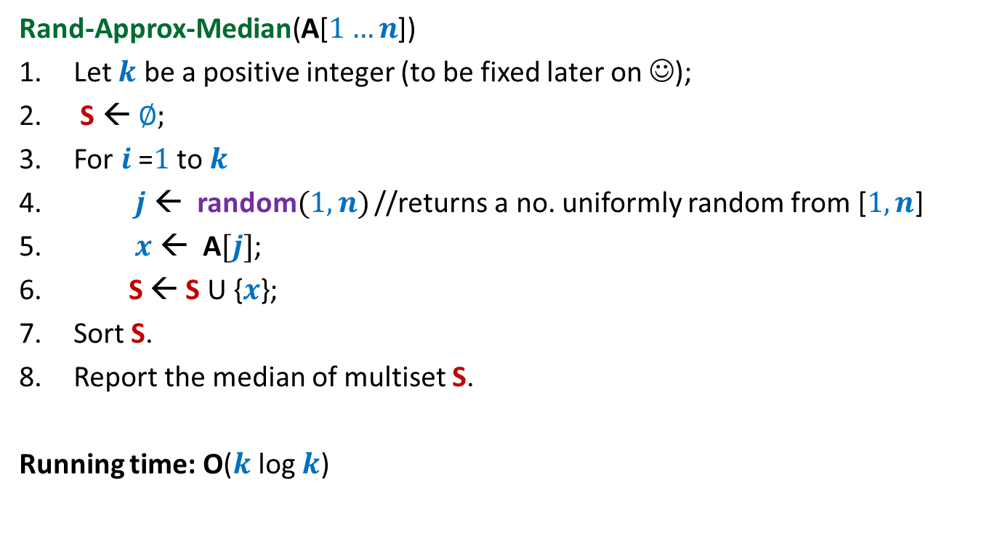
½ - Approximate median A Randomized Algorithm
Rand-Approx-Median(A[$1…n$])
Let $k$ be a positive integer (to be fixed later on ☺);
S ← ∅;
For $i$=$1$ to $k$
$j$ ← random$(1,n)$ //returns a no. uniformly random from [$1,n$]
$x$ ← A$[j]$;
S ← S U {$x$};
Sort S.
Report the median of multiset S.
Running time: O($k$ log $k$)

Slide 11
Analyzing the error probability of Rand-approx-median
$$n/4$$
Elements of A arranged in Increasing order of values
$$3n/4$$
Left Quarter
Right Quarter
Lets us consider an instance of sample set S

Slide 12
Analyzing the error probability of Rand-approx-median
$$n/4$$
Elements of A arranged in Increasing order of values
$$3n/4$$
Median of S
Left Quarter
Right Quarter
Answer is correct
When does Rand-approx-median make an error ?

Slide 13
Analyzing the error probability of Rand-approx-median
$$n/4$$
Elements of A arranged in Increasing order of values
$$3n/4$$
Median of S
Left Quarter
Right Quarter
Answer is incorrect
What might have gone wrong with S ?

Slide 14
Analyzing the error probability of Rand-approx-median
Observation:
Rand-approx-median makes an error if and only if
……………………………………………?.......................................
$$n/4$$
Elements of A arranged in Increasing order of values
$$3n/4$$
Median of S
Left Quarter
Right Quarter
More than $k/2$ elements got sampled from the Right Quarter
(or Left Quarter).

Slide 15

Analyzing the error probability of Rand-approx-median
Pr[ An element selected randomly from A is from Right quarter] = ??
Pr[ Out of $k$ elements sampled from A, at least $k/2$ are from Right quarter] = ??
$≤{ (1/2)}^{k/5}$
$={ (1/2)}^{2 log{ n}}$ for $k=10\log{n}$
$={ n}^{−2}$
$$n/4$$
Elements of A arranged in Increasing order of values
$$3n/4$$
Left Quarter
Right Quarter
¼
Exactly the same as the coin tossing exercise we did ☺ !

Slide 16

Theorem:
The Rand-approx-median algorithm runs in $O(log n loglog n)$ time.
The algorithm fails to report ½ -approximate median from array A[1.. $n$]
with probability at most${ 2n}^{−2}$.

Slide 17
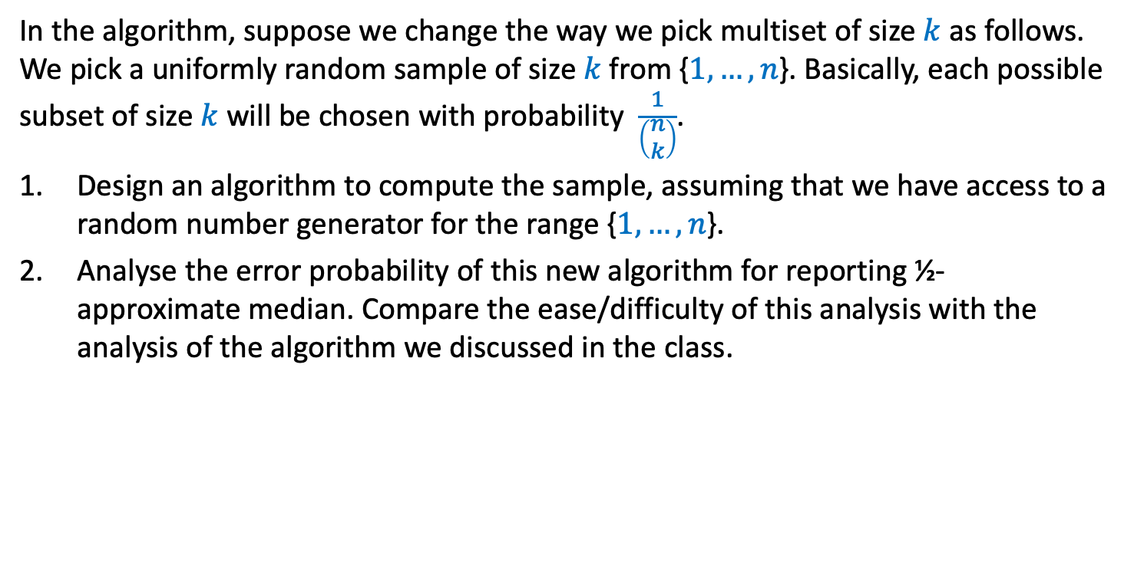
Homework
In the algorithm, suppose we change the way we pick multiset of size $k$ as follows. We pick a uniformly random sample of size $k$from {$1,…,n$}. Basically, each possible subset of size $k$ will be chosen with probability $\frac{1}{\left(\begin{matrix}n \\ k\end{matrix}\right)}$.
Design an algorithm to compute the sample, assuming that we have access to a random number generator for the range {$1,…,n$}.
Analyse the error probability of this new algorithm for reporting ½-approximate median. Compare the ease/difficulty of this analysis with the analysis of the algorithm we discussed in the class.

Slide 18
Fingerprinting technique
Application
Checking equality of files

Slide 19



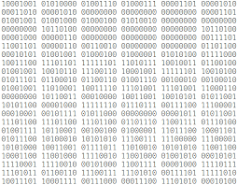

Fingerprinting
Fingerprints don’t capture the complete information of a person. Still fingerprinting is used and it works well in practice. What is the reason ?
Reason: The aim is to be able to distinguish two different persons. For this purpose finger prints suffice since every two human beings (even twins) have distinct finger prints.
Applications : Cryptography

Slide 20

A motivating example from real world
Queries or updates
Database

Slide 21
A motivating example from real world
New Delhi
New York
Synchronize at regular intervals

Slide 22





The Problem
Aim: To determine if File A is identical to File B by communicating fewest bits ?
Network
File A
File B
size(A) = $n$ bits
size(B) = $n$ bits
 | No. of bits to be sent
Deterministic algorithm
$$n$$
Randomized algorithm
O(log($n$))

Slide 23






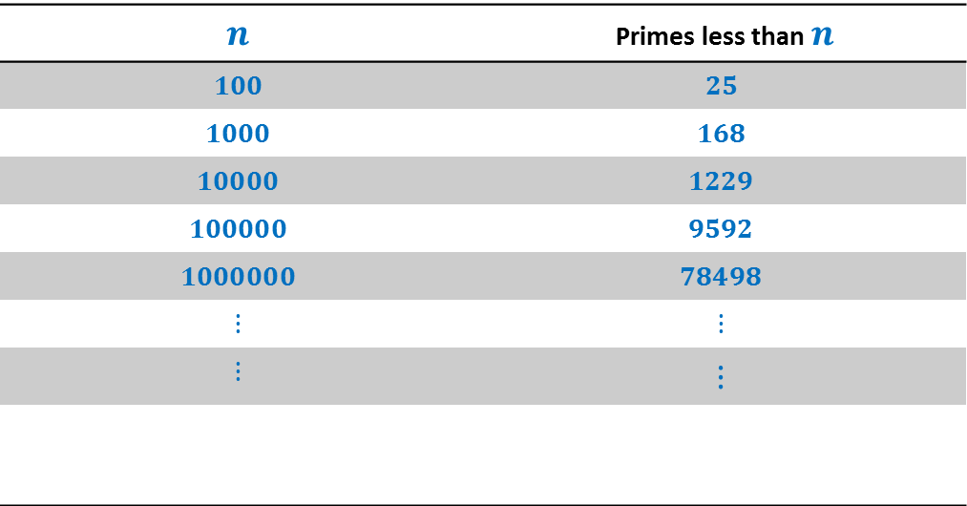
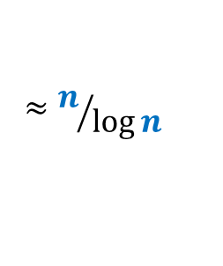




How many primes less than $n$ ?
$$n$$ | Primes less than $n$
$$100$$ | $$25$$
$$1000$$ | $$168$$
$$10000$$ | $$1229$$
$$100000$$ | $$9592$$
$$1000000$$ | $$78498$$
$$⋮$$ | $$⋮$$
$$⋮$$ | $$⋮$$
$π\left(n\right)$:
$$π\left(n\right)$$
$$≈n/{\log{n}}$$
Huge gap
Interestingly this simple fact alone will be used in devising the algorithm.
How many prime factors of $n$ ?
$$<\log{n}$$
$$=$$
$$2^{2}∙5^{3}∙7$$
$$3500$$
$$2^{2}∙5^{3}∙7$$
$$\{2,5,7\}$$
Notes:
Randomization will exploit this huge difference to achieve a very simple and elegant algorithm.

Slide 24
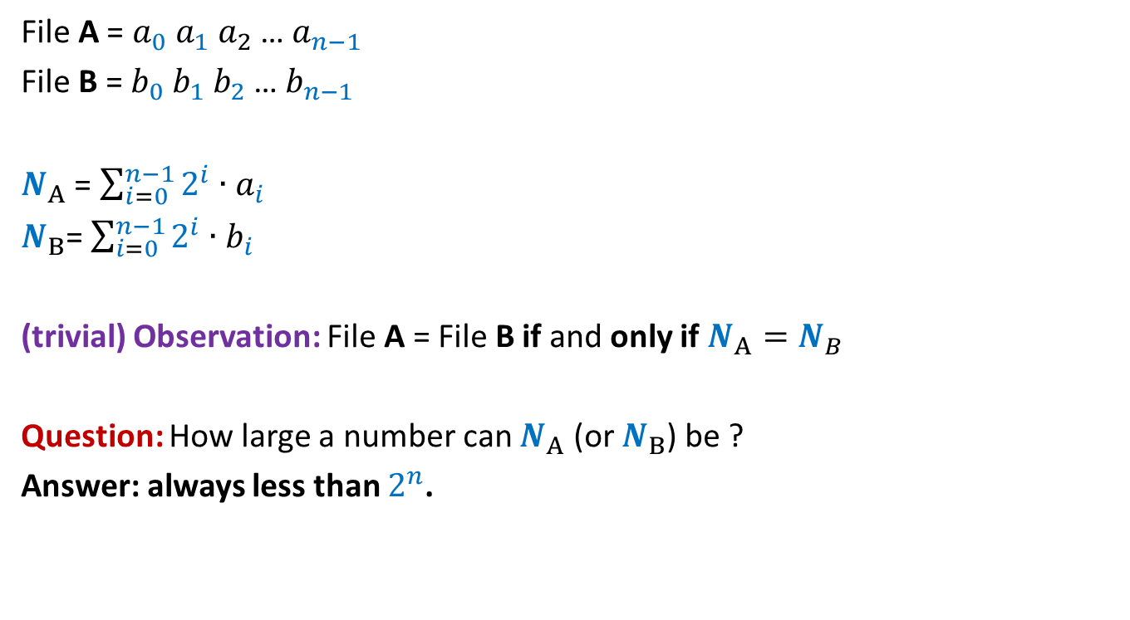
Key idea: Visualize a file as a binary number
File A = $a_{0} a_{1} a_{2}$… $a_{n−1}$
File B = $b_{0} b_{1} b_{2}$… $b_{n−1}$
$N_{A}$ = $\sum_{i=0}^{n−1}{2^{i}∙a_{i}}$
$N_{B}$= $\sum_{i=0}^{n−1}{2^{i}∙b_{i}}$
(trivial) Observation: File A = File B if and only if $N_{A}=N_{B}$
Question: How large a number can $N_{A}$ (or $N_{B}$) be ?
Answer: always less than $2^{n}$.

Slide 25

Network
File A
File B
size(A) = $n$ bits
size(B) = $n$ bits
What should be ?

Slide 26
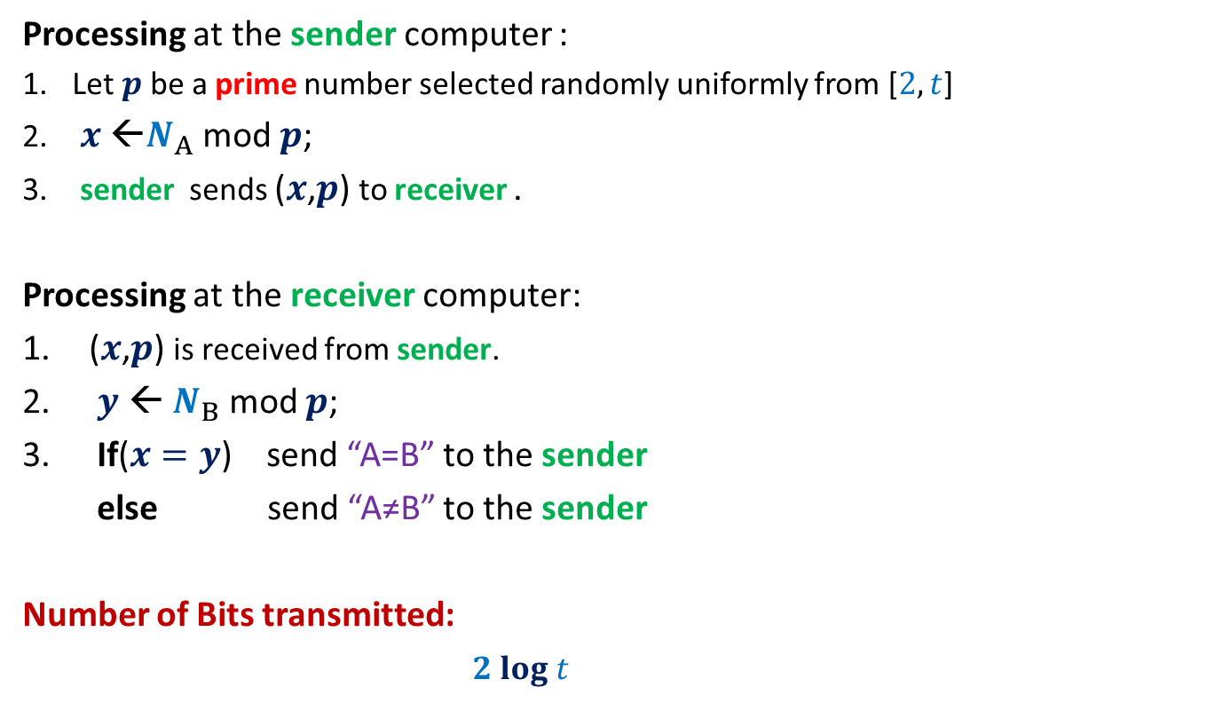
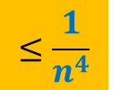
RandomEqualityChecking-Protocol($A$,$B$)
Processing at the sender computer :
Let $p$be a prime number selected randomly uniformly from [$2,t$]
$x$ ←$N_{A}$ mod $p$;
sender sends ($x$,$p$) to receiver .
Processing at the receiver computer:
($x$,$p$) is received from sender.
$y$ ← $N_{B}$ mod $p$;
If($x=y$) send “A=B” to the sender
else send “A≠B” to the sender
Number of Bits transmitted:
$2 log t$

Slide 27





Error Analysis
Cases
$$N_{A}=N_{B}$$
No error
$N_{A}mod p=N_{B} mod p$
$$N_{A}mod p=N_{B} mod p$$
$$N_{A}≠N_{B}$$
?
$$with some probability$$

Slide 28






Error Analysis
Cases
Let $d$ = $|N_{A}− N_{B}|$
Observation: If $N_{A}≠N_{B}$, then surely $d>0$.
The protocol makes an error if and only if
$N_{A} mod p=N_{B} mod p$
$N_{A} mod p−N_{B} mod p=0$
($N_{A} −N_{B}$) $mod p$ $=0$
$p$divides $d$
$$N_{A}=N_{B}$$
No error
$N_{A}mod p=N_{B} mod p$
$$N_{A}mod p=N_{B} mod p$$
$$N_{A}≠N_{B}$$
?
$$with some probability$$

Slide 29





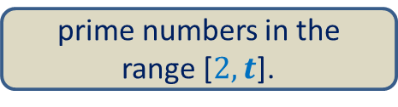





Error Analysis
Cases
$$N_{A}=N_{B}$$
No error
$N_{A}mod p=N_{B} mod p$
$$N_{A}mod p=N_{B} mod p$$
$$N_{A}≠N_{B}$$
$$≤\frac{n}{π(t)}$$
$$with some probability$$
$$1$$
$$d$$
$$2^{n}$$
The prime factors of $d$
$$≤n$$
$$1$$
$$t$$
prime numbers in the range [$2,t$].
$$≈\frac{t}{log t }$$
$$π(t)$$

Slide 30

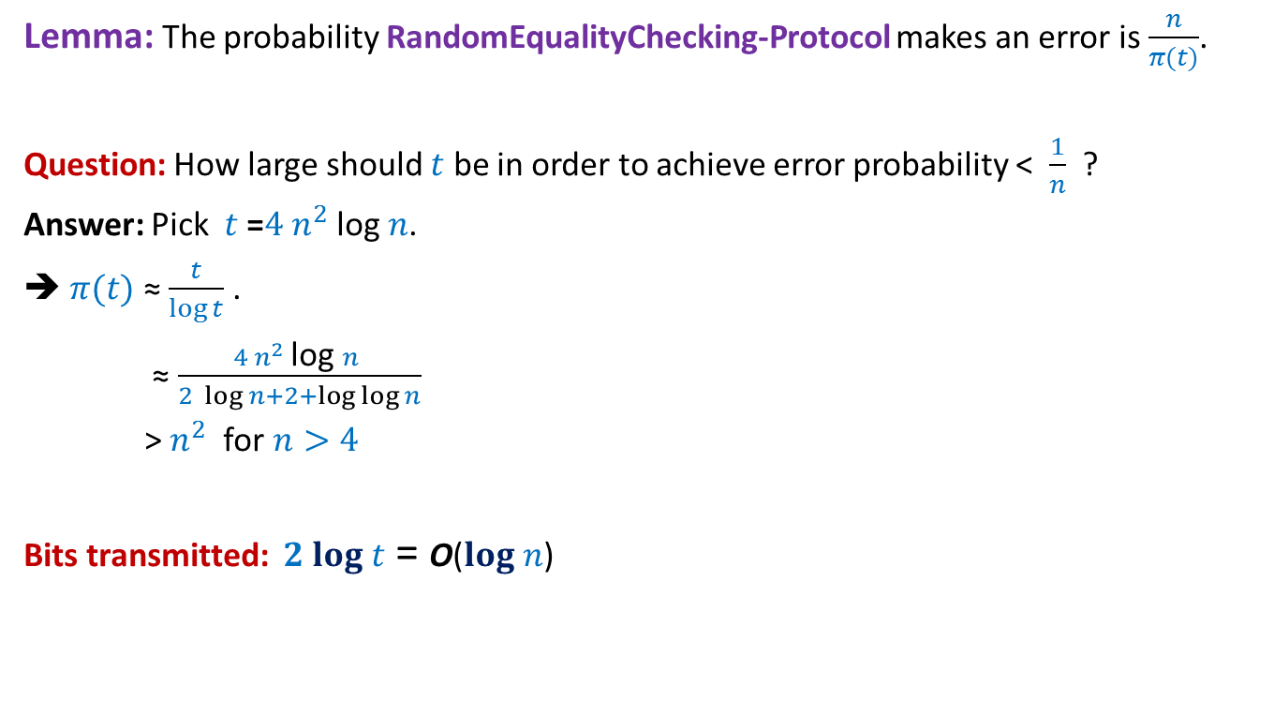
Error Analysis
Lemma: The probability RandomEqualityChecking-Protocol makes an error is $\frac{n}{π(t)}$.
Question: How large should $t$ be in order to achieve error probability < $\frac{1}{n}$ ?
Answer: Pick $t$ =$4 n^{2}$log $n$.
➔ $π(t)$ ≈ $\frac{t}{\log{t}}$ .
≈ $\frac{4 n^{2} \text{log} n }{2 \log{n}+2+\log{\log{n}}}$
> $n^{2}$ for $n>4$
Bits transmitted: $2 log t$ = O($log n$)
$$≈\frac{t}{log t }$$
$$π(t)$$

Slide 31

Homework
Consider the following variant of the algorithm.
Instead of picking just one prime numbe randomly uniformly,
We pick $k$prime numbers randomly uniformly and independently from range [$2,t$].
For each prime number selected, we compute its fingerprint.
We send $k$ pairs of prime numbers and their respective fingerprints to sender.
What error bound will you achieve in this case ?

Slide 32
Important note
The Fingerprint based algorithm discussed in the lecture is just a toy example from cryptography. However, it emphatically demonstrate the power of randomization.
In the real world, there are quite sophisticated protocols which are more robust for verifying equality of two files than the protocol we discussed.

